Slide 1
Group: Sentiment and Opinion
Members
Keli Dara-Ahato | Merve Güzeldal
Pascal Breuer | Patrick Neumann
Xuefeng Song | Marleen Matjeka

Slide 2
What we did
Apply our Model to MBFC Dataset from Group 5
With Different Thresholds
Sort Out All Sentiment Datasets
Solve Problems of Old Opinion Datasets
Collect More and Sort Out All New Opinion Datasets
Preprocess New Opinion Datasets
Basic Result Analysis
Confidence Probability of Right Classification
with Different Classifiers

Slide 3
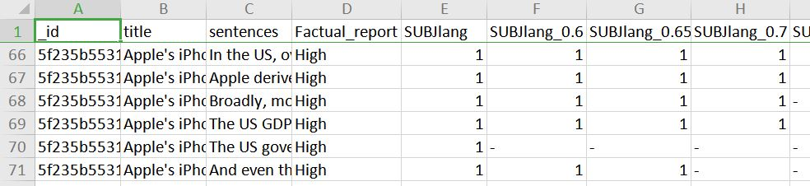
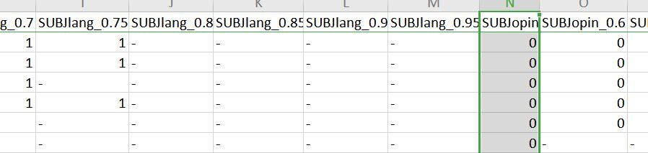
Apply our Model to MBFC Dataset from Group 5
With Different Thresholds

Slide 4
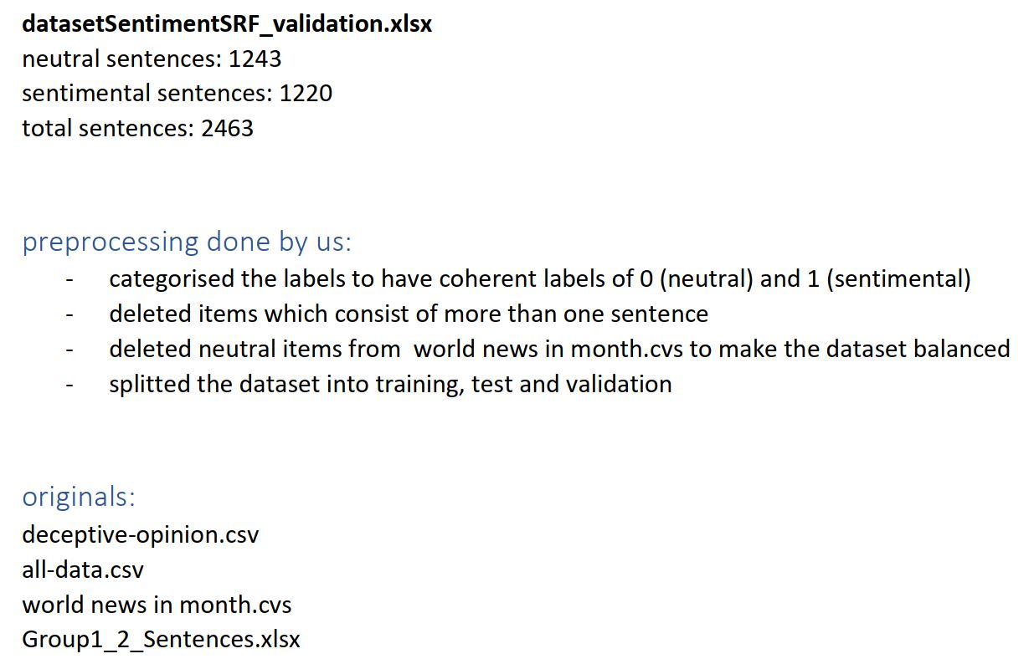
Sort out Sentiment Datasets

Slide 5
Sort out New Opinion Datasets
To find Datasets
to differentiate/determine Opinion or Fact.
to determine if a Sentence includes Opinions.
#Dataset Name- Source- how many Items- possible Values

Slide 6
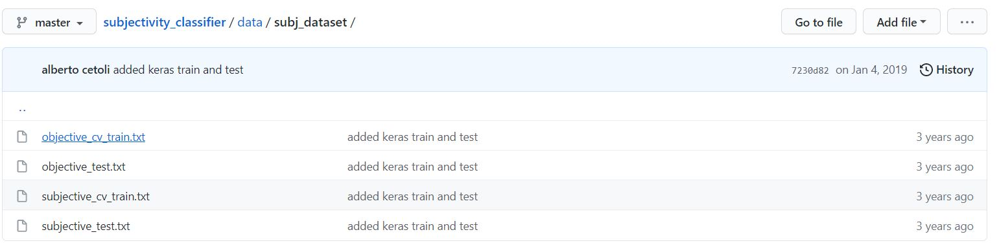
Solve Problems of Old Opinion Datasets
in opinionDataset.xlsx
Rows 2214, 8176, 19242, 19932 are 4 Items with same Sentences, but 2 of them has Value 0, 2 Items has Value 1?

Slide 7
Solve Opinion Datasets
To find Datasets
to differentiate/determine Opinion or Fact.
to determine if a Sentence includes Opinions.
#Dataset Name- Source- how many Items- possible Values

Slide 8
Collect More Opinion Datasets
0. A- Group1_2_Sentences.xlsx `TrainingdataNew.xlsx
#3302Items
#For Sentiment:
SUBJlang 1 or 3 or 5
SUBJlang01 0 or 1
#For Opinion:
SUBJopin: 1 or 3 or 5 (or 0 with only 1 Item)
SUBJopin01: 0 or 1
1. B- Opinosis `OpinosisDataset1.0_0.zip `opinosis-topics `....txt.data`opinosis-topics.xlsx
http://kavita-ganesan.com/opinosis-opinion-dataset/#.YNGdT-j7RPY
#7253 Items
1 as Opinion

Slide 9
Collect More Opinion Datasets
2. C-
opinion-or-fact-sentence-classifier `opinion_fact_sentences.pickle `opinion_fact_sentences.xlsx
https://github.com/espressoctopus/opinion-or-fact-sentence-classifier
I tried to decode the pickle-Document myself, but not so successful.
Then I tried to directly get the WiKi-Articles processing `gather_and_prepare_data.py, but also have a problem. I can get the titles but not the content of articles.
#ca. 15000 Items
0 as Facts (from Wikipedia-Sentences)
3. D-
Sparse-Interpretable-Word-Embeddings-For-Medical-Domain
`bc.csv+chr.csv+fp.csv
https://github.com/Institute-for-Artificial-Intelligence/Sparse-Interpretable-Word-Embeddings-For-Medical-Domain
#959+1709+967 =more than 3500 Items
factuality-EXPERIENCE or FACT or OPINION or NOT_LABELED

Slide 10
Collect More Opinion Datasets
4. E-Fact-vs-Opinion-Articles `dataset.csv `Fact-vs-Opinion-Articles_dataset.csv
https://github.com/CarolineLiong/Fact-vs-Opinion-Articles
#357 Items
NON_FACTUAL or FACTUAL
5. F-Fact-Checker `train.csv
https://github.com/ongweekeong/Fact-Checker
#22501 Items.
-1 0 1 (-1 as Opinion)
9. K-
subjectivity_classifier `subj_dataset `opinionDataset.xlsx
https://github.com/fractalego/subjectivity_classifier
#9999 Items
0 1

Slide 11
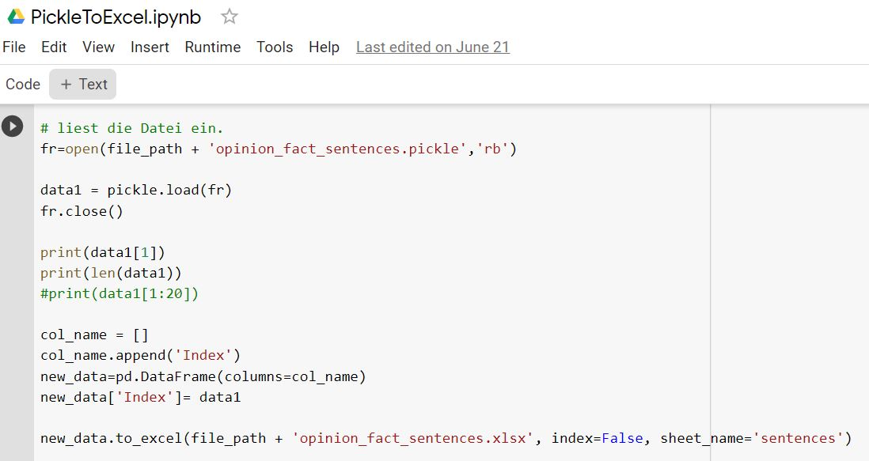
Collect More Opinion Datasets
opinion_fact_sentences.pickle

Slide 12
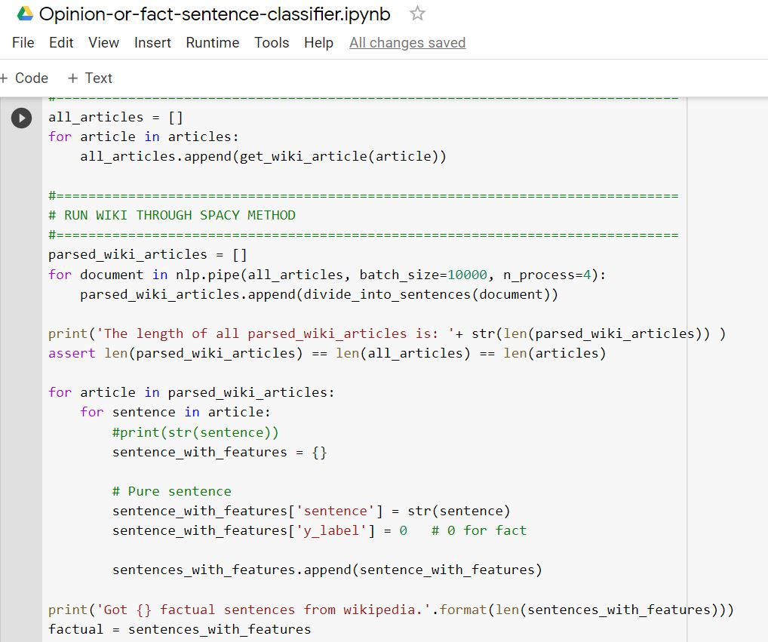
Collect More Opinion Datasets
Try to get WiKi Articles and split into Sentences as Facts
Failed…

Slide 13
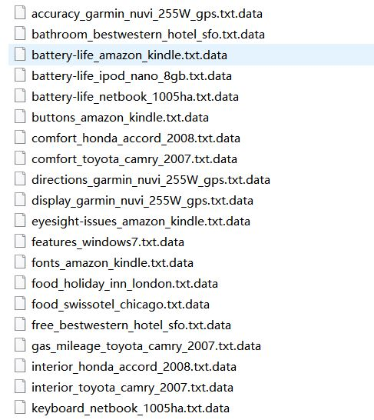
Collect More Opinion Datasets
Get Opinions from 51 Data in Dataset Opinosis

Slide 14
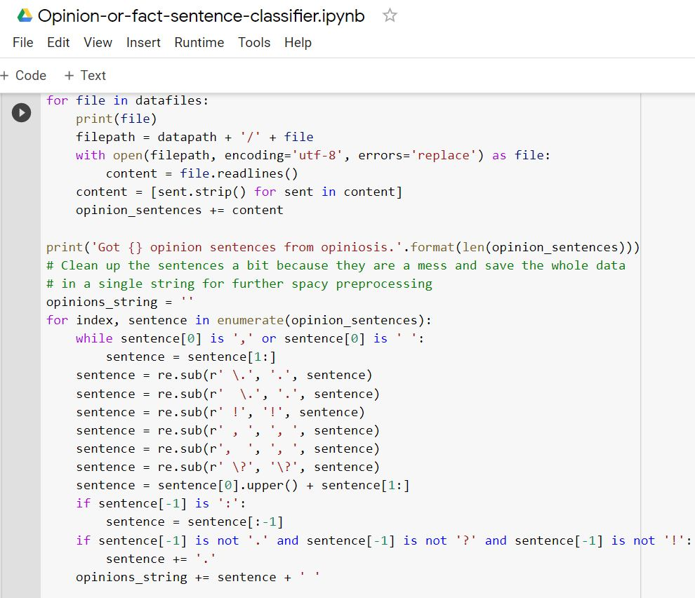
Collect More Opinion Datasets
Get Opinions from Dataset Opinosis
Success

Slide 15
Basic Result Analysis
Opinion Many Sentences that contain Opinions are classified as not Opinions.
- because if youre stupid enough to believe what the new york times publishes youre stupid enough to pay 300 for a tshirt - or maybe cuba - 2 going on his i hate capitalism give my corporate masters moolah tour of america - httpswwwlewrockwellcomlrcblogrequestionsforthenextsupremecourtnominee i am getting very interesting feedback from lrc readers on my earlier blog concerning national security questions to be asked to the next supreme court appointment of president trump
Sentiment Many not sentimentale Sentences are classified as sentimental
- √ó former american idol contestant found guilty of hitting bouncer during bar fight palatine ill - Sidney Crosby scored his first two goals of the season, including a dazzling overtime winner, as the Pittsburgh Penguins emerged with a 6-5 victory over the ...
Notes:
Aker 说此比较无意义，因为Test-Dataset不同。

Slide 16
Confidence Probability of Right Classification
Filter the Items with Accuracy lower than a certain threshold like 70%
Get new results
for threshhold: 0.7
Dropped Entries: 211
Remaining Entries: 2252 of 2463
Used estimator: BernoulliNB
Used transformers: TextToSentenceTransformer, BertTransformer, PreprocessorTransformer, SentimentOpinionValueCalculatorSingleValueTransformer
Column: SUBJlang01
Accuracy: 0.5559502664298401
F1 Score: 0.5395316943642552
Recall Score: 0.5559502664298401
Precision Score: 0.5604902512351319

Slide 17
What we did – Table with all computed values
 | Classifier | Accuracy | Precision | Recall | f-Score
Sentiment | Textblob and Pattern3 | 0.57 | 0.53 | 0.57 | 0.54
Opinion | Textblob and Pattern3 | 0.57 | 0.57 | 0.57 | 0.57
Sentiment | Vader | 0.506 | 0.499 | 0.506 | 0.460
Sentiment | Logistic Regression | 0.626 | 0.626 | 0.626 | 0.626
Opinion | Logistic Regression | 0.68 | 0.65 | 0.68 | 0.63

Slide 18
Confidence Probability of right classification
Logistic Regression | Threshold | Accuracy | Precision | Recall | f-Score
Sentiment | no | 0.626 | 0.626 | 0.626 | 0.626
Sentiment | 70% | 0.805 | 0.810 | 0.805 | 0.804
Sentiment | 80% | 0.906 | 0.911 | 0.906 | 0.908
Opinion | no | 0.68 | 0.65 | 0.68 | 0.63
Opinion | 70% | 0.802 | 0.643 | 0.802 | 0.714
Opinion | 80% | 0.874 | 0.764 | 0.874 | 0.816
Notes:
Aker 说此比较无意义，因为Test-Dataset不同。

Slide 19
Confidence Probability of Right Classification
with Different Classifiers
Threshold 70% 2463 Items | Classifier | Dropped Items | Accuracy | Precision | Recall | f-Score
Sentiment | Logistic Regression | 1552 | 0.72 | 0.73 | 0.72 | 0.72
Sentiment | GaussianNB | 2461 | 0.5 | 0.25 | 0.5 | 0.33
Sentiment | BernoulliNB | 211 | 0. 56 | 0.56 | 0.56 | 0.54
Sentiment | SVM/SVC | 1996 | 0.78 | 0.79 | 0.78 | 0.78
Notes:
Aker 说此比较无意义，因为Test-Dataset不同。

Slide 20
Confidence Probability of Right Classification
with Different Classifiers
Threshold 80% 2463 Items | Classifier | Dropped Items | Accuracy | Precision | Recall | f-Score
Sentiment | Logistic Regression | 2054 | 0.81 | 0.82 | 0.81 | 0.81
Sentiment | GaussianNB | 2463 | nan | 0 | 0 | 0
Sentiment | BernoulliNB | 347 | 0. 55 | 0.56 | 0.55 | 0.53
Sentiment | SVM/SVC | 2416 | 0.85 | 0.85 | 0.85 | 0.85
Notes:
Aker 说此比较无意义，因为Test-Dataset不同。

Slide 21
Next Week
Sort Out All Opinion Datasets
Merge, Split and Apply New Opinion Datasets
More Result Analysis
Continue Improving Our Baselines
with More Different Classifiers
New Manager:
Patrick Neumann

